Slide 1

MATH 323
Graph Theory
Cr. 3
Dr. Bhadra Man Tuladhar
MATH 323 Graph Theory Lecture 7

Slide 2

Shortest Path Problem
Given a connected graph G with a weight function, find the minimum weighted distance d(u,v) for given u,v∈G.
Assume that G is a connected graph. Dijkstra's algorithm solves the problem for every pair u, v, where u is a fixed starting point and v∈G. Let us make the convention that α(uv) = ∞, if uv∉E_{G}.
MATH 323 Graph Theory Lecture 7

Slide 3
Dijkstra's algorithm
(i) Set u₀ = u, t(u₀) = 0 and t(v) = ∞ for all v≠u₀.
(ii) For i∈[0, V_{G}-1]: for each v∉{v₁, …,v_{i}}, replace t(v) by min{t(v); t(u_{i}) + α(u_{i}v)}. Let u_{i+1} ∉{u₁,…, u_{i}} be any vertex with the least value t(u_{i+1}).
(iii) Conclusion: d(u,v) =t(v).
MATH 323 Graph Theory Lecture 7

Slide 4
Example
Apply Dijkstra's algorithm to the vertex v₀ in the given graph:
2
2
v₁
1
v₃
1
2
3
2
v₅
v₀
3
2
v₂
1
v₄
MATH 323 Graph Theory Lecture 7

Slide 5

Step 1
u₀ = v₀, t(u₀) = 0, others are ∞.
2
2
v₁
1
v₃
1
u₀
2
3
2
v₅
v₀
3
2
v₂
1
v₄
MATH 323 Graph Theory Lecture 7

Slide 6
Step 2
t(v₁) = min{∞, 2} = 2, t(v₂) = min{∞, 3}= 3 others are ∞. Thus u₁ = v₁
2
u₁
2
v₁
1
v₃
1
u₀
2
3
2
v₅
v₀
3
2
v₂
1
v₄
MATH 323 Graph Theory Lecture 7

Slide 7
Step 3
t(v₂) = min{t(v₂), t(u₁)+α(u₁v₂)} = min{3,2+2} = min{3,4} = 3
t(v₃) = 2+1= 3, t(v₄) = 2+3= 5, t(v₅) = 2+2= 4
Thus choose u₂ = v₃
2
u₁
u₂
2
v₁
1
v₃
1
u₀
2
3
2
v₅
v₀
3
2
v₂
1
v₄
MATH 323 Graph Theory Lecture 7

Slide 8
Step 4
t(v₂) = min{3, ∞} = 3, t(v₄) = min{t(v₄), t(u₂)+ α(u₂v₄)} = min{5, 3+2} = 5, t(v₅) = min{t(v₅), t(u₂)+ α(u₂v₅)} = min{4, 3+1} = 4 Thus set u₃ = v₂
2
u₁
u₂
2
v₁
1
v₃
1
u₀
2
3
2
v₅
v₀
3
2
u₃
v₂
1
v₄
MATH 323 Graph Theory Lecture 7

Slide 9
Step 5
t(v₄) = min{t(v₄), t(u₃)+ α(u₃v₄)} = min{5, 3+1} = 4, t(v₅) = min{t(v₅), t(u₃)+ α(u₃v₅)} = min{4, ∞} = 4. Thus choose u₄ = v₄
2
u₁
u₂
2
v₁
1
v₃
1
u₀
2
3
2
v₅
v₀
3
2
u₃
v₂
1
v₄
u₄
MATH 323 Graph Theory Lecture 7

Slide 10
Step 6
t(v₅) = min{t(v₅), t(u₄)+ α(u₄v₅)} = min{4, 4+2} = 4. The algorithm stops.
2
u₁
u₂
2
v₁
1
v₃
1
u₀
2
3
2
v₅
v₀
3
2
u₃
v₂
1
v₄
u₄
MATH 323 Graph Theory Lecture 7

Slide 11
Step 7
We have obtained t(v₁) = 2, t(v₂) = 3, t(v₃) = 3, t(v₄) = 4, t(v₅) = 4.
2
u₁
u₂
2
v₁
1
v₃
1
u₀
2
3
2
v₅
v₀
3
2
u₃
v₂
1
v₄
u₄
MATH 323 Graph Theory Lecture 7

Slide 12
Exercise
Apply Dijkstra's algorithm to the vertex v₀ in the given graph:
3
3
4
v₁
v₃
v₅
u₀=
5
2
2
1
v₀
2
3
2
2
3
v₂
2
v₄
2
v₆
MATH 323 Graph Theory Lecture 7

Slide 13
Shortest Spanning Tree
Kruskal’s algorithm require listing all edges in order of non-decreasing order.
An alternative to Kruskal’s algorithm is Prim’s algorithm.
For Prim’s algorithm, draw n isolated vertices and label them.
Tabulate the given weights of the edges of graph G in a n×n table.
Set the weight of non existent edge as very large (∞).
MATH 323 Graph Theory Lecture 7

Slide 14

Prim’s Algorithm
Start from vertex v₁ and connect it to its neighbour, say v_{k}.
Consider v₁ and v_{k} as one subgraph.
Connect this subgraph to its closest neighbour. Let this vertex be v_{i}.
Regard the tree with vertices v₁, v_{k} and v_{i}.
Continue the process until all n vertices have been connected by n – 1 edges.
MATH 323 Graph Theory Lecture 7

Slide 15
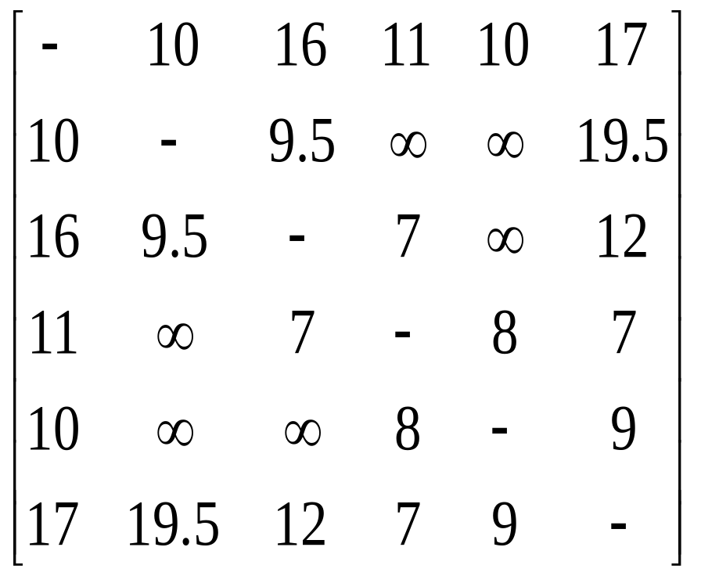
Example
Consider the graph G
v₅
10
v₁
9
8
17
10
11
v₆
v₄
16
v₂
7
7
12
9.5
v₃
19.5
A connected graph with 6 vertices and 12 edges.
MATH 323 Graph Theory Lecture 7

Slide 16
Shortest Spanning Tree
- | 10 | 16 | 11 | 10 | 17
10 | - | 9.5 | ∞ | ∞ | 19.5
16 | 9.5 | - | 7 | ∞ | 12
11 | ∞ | 7 | - | 8 | 7
10 | ∞ | ∞ | 8 | - | 9
17 | 19.5 | 12 | 7 | 9 | -
Total = 41.5
MATH 323 Graph Theory Lecture 7

Slide 17
Example
Shortest Spanning Tree is shown in red.
v₅
10
v₁
- | 10 | 16 | 11 | 10 | 17
10 | - | 9.5 | ∞ | ∞ | 19.5
16 | 9.5 | - | 7 | ∞ | 12
11 | ∞ | 7 | - | 8 | 7
10 | ∞ | ∞ | 8 | - | 9
17 | 19.5 | 12 | 7 | 9 | -
9
8
17
10
11
v₆
v₄
16
v₂
7
7
12
9.5
v₃
19.5
Total weight of the tree = 41.5
MATH 323 Graph Theory Lecture 7

Slide 18
Exercise
Use Prim’s algorithm to find the shortest (minimal) spanning tree of the given graph.
A
B
8
2
7
7
6
D
C
4
9
3
6
E
F
Use Kruskal’s algorithm and compare the efficiencies.
MATH 323 Graph Theory Lecture 7

Slide 19
Distance d(v_{i},v_{j})
In a connected graph G, the distance d(v_{i},v_{j}) between two of its vertices v_{i} and v_{j} is the length of the shortest path.
a
d(a,b) = 1
d(a,c) = 2
d
b
c
d(c,b) = 1
d(a,d) = 2
MATH 323 Graph Theory Lecture 7

Slide 20
Eccentricity
The eccentricity E(v) of a vertex v in a graph G is the distance from v to the vertex farthest from v in G.
a
E(a) = 2
E(b) = 1
E(c) = 2
d
b
c
E(d) = 2
MATH 323 Graph Theory Lecture 7

Slide 21
Center of G
A vertex with minimum eccentricity in graph G is called a center of G.
center
a
E(a) = 2
E(b) = 1
E(c) = 2
d
b
c
E(d) = 2
MATH 323 Graph Theory Lecture 7

Slide 22
Centers of G
If two vertices have the same minimum eccentricity, then both vertices are centers.
e
a
b
d
c
f
centers
MATH 323 Graph Theory Lecture 7

Slide 23
Theorem
Every tree has either one or two centers.
Other types of graphs may have many centers.
In a graph that consists of just a circuit, every vertex is a center.
MATH 323 Graph Theory Lecture 7

Slide 24
Radius
The eccentricity of a center in a tree is defined as the radius (radT) of the tree.
T
4
c
4
3
2
3
4
The numbers represents the eccentricity of the vertex
radT = 2
MATH 323 Graph Theory Lecture 7

Slide 25
Diameter
The diameter (diamT) of a tree is defined as the length of the longest path in the tree.
T
4
c
4
3
2
3
4
diamT = 4
Note: A radius of a tree is not necessarily half its diameter.
MATH 323 Graph Theory Lecture 7

Slide 26
Exercise
1. Denote the eccentricities of all the vertices of the given tree. Also find its center and diameter.
2. Draw a tree in which its diameter is not equal to twice the radius.
MATH 323 Graph Theory Lecture 7

Slide 27
Sorting of Mail
The sorting of mails according to zip code are done according to a tree called decision tree or sorting tree.
N₂
N₁
N₀
N
MATH 323 Graph Theory Lecture 7

Slide 28
Rooted Tree
A tree in which one vertex (called the root) is distinguished from all the others is called a rooted tree.
Rooted Tree with N as the root.
Root is generally marked distinctly.
N₂
N₁
N₀
N
MATH 323 Graph Theory Lecture 7

Slide 29
More Next Time
MATH 323 Graph Theory Lecture 7

